Slide 1

Unit 1: Logic review
Computer Science Department
University of Verona - Italy

Slide 2
Propositional logic, First-Order Logic, Davis-Putnam method
Unit 1 – Lecture 1.1 and 1.2

Slide 3
Agenda
Classic propositional calculus
Syntax and semantics
The proof system
First order calculus
Syntax and semantics
The proof system
Reasoning tasks in FOL e CPC
Soundness, completeness and computational complexity

Slide 4
CPC
Language
Signature
Letters
Connectives ∧, ∨, ¬, → (AND OR NOT IMPLIES)
Parentheses (, )
Syntax
𝝋 is a well-formed formula (wff) if it is
A letter
Being 𝝋 wff, ¬𝝋, (𝝋)
Being 𝝋 e 𝟁 wff, 𝝋 ∧ 𝟁, 𝝋 ∨ 𝟁, 𝝋 → 𝟁, (𝝋 ∧ 𝟁), (𝝋 ∨ 𝟁), (𝝋 → 𝟁)

Slide 5
Semantics of CPC
Formula
A formula is either TRUE or FALSE
Compositionality
Given an interpretation of letters, formulae can be obtained in a deterministic fashion

Slide 6
Satisfiability
A formula is SAT when there is an interpretation that makes the formula true
A formula that is true for all its interpretations is said to be tautologic
Unsat formulae are contradictions

Slide 7
Theories
A set of formulae is said to be a propositional theory
A theory is consistent iff there is an interpretation of the letters that make all the formulae in the theory true

Slide 8
Derivation and inferential appartuses
Logical system are tools that generate new formulae
A formula that is generated by a theory having associated to the calculus a set of axioms is a theorem (see afterwards)
Calculi with associated sets of axioms are equivalent to theories

Slide 9
Rules and inference
A pair r:<Γ,𝜹> is an inferential rule when the set Γ is formed by wffs and 𝜹 is a wff
We name inferential system a set of inferential rules

Slide 10
Derivation in logical systems
A formula 𝝋 is derived (directly) from a set A of wff, written A ⊢ 𝝋, in an inferential system S, when there is a rule r:<Γ, 𝝋> in S with Γ ⊆ A
Given two sets of wffs A and B, such that every formula of B is derived from A we extensively say that A derives (directly) B
We then say that A derives indirectly 𝝋 (and again extensively, we can apply this to a set) when there is sequence of sets A₁, A₂,…, A_{n},… such that for any i, A_{i} derives A_{i+1}

Slide 11
Theoretical derivation
Given a theory T, we name axioms of that theory a subset A of T, such that each element of T is derived from A
A theory T is said to be closed when every element 𝝋 derived from a set of axioms for is in T
An element of a theory T is named theorem
The set of all theorems derived is called deductive closure

Slide 12
Theories, derivation and sat
Every tautology is a theorem in a consistent theory
Given a consistent theory, every formula that is sat when the axioms are so, is sat as well
If you derive 𝝋 in a consistent theory T than the theory T’ obtained by adding 𝝋 to T is consistent

Slide 13
T-sat
Given a theory T, a formula 𝝋 is T-sat when one of the interpretations that satisfies T, also does so with 𝝋

Slide 14
Properties of inferential systems
An inferential system is sound when it only derives tautologies when starting with the empty set, and T-sat formulae when starting with the axioms of T
An inferential system is complete when it derives all tautologies when starting with the empty set, and all T-sat formulae when starting with the axioms of T

Slide 15
Prawitz’s presentation
A system of rules sound and complete for CPC
Essentially based on Aristotle’s foundational logic postulates
Non-contradiction principle (you cannot derive both a formula and its contrary)
Tertium non datur (when you do not derive a formula, you derive its contrary)

Slide 16

Conjunction rules
$\frac{α∧β}{α}$ $∧$-LE $\frac{α∧β}{β}$ $∧$-RE
$\frac{α β}{α∧β}$ $∧$-I

Slide 17
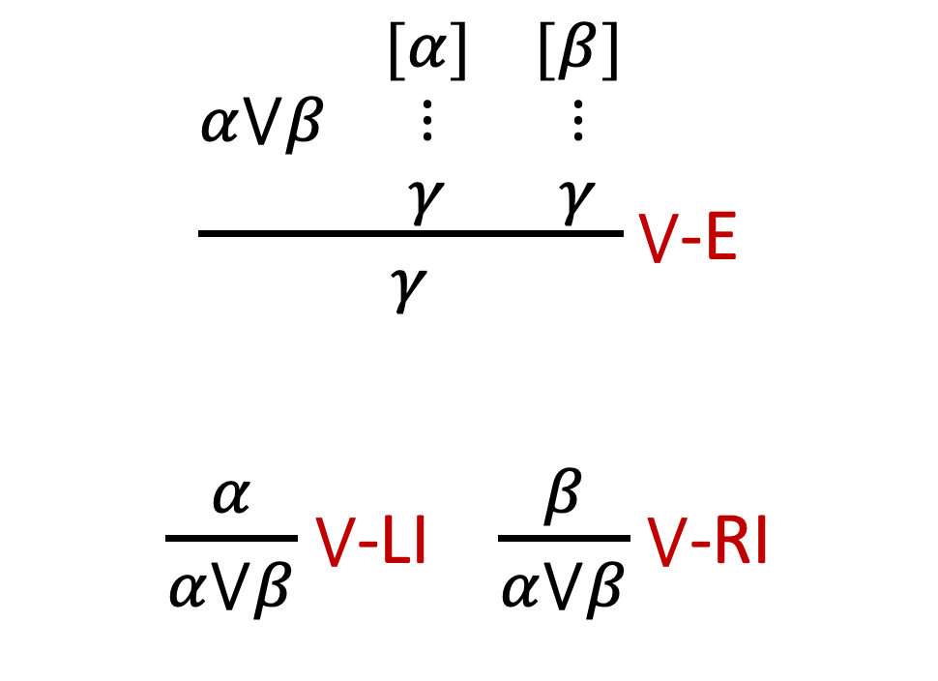
Disjunction rules
$\frac{α⋁β \begin{matrix}[α] & [β] \\ ⋮ & ⋮ \\ γ & γ\end{matrix}}{γ}⋁$-E
$\frac{α}{α⋁β}$ $⋁$-LI $\frac{β}{α⋁β}$ $⋁$-RI

Slide 18
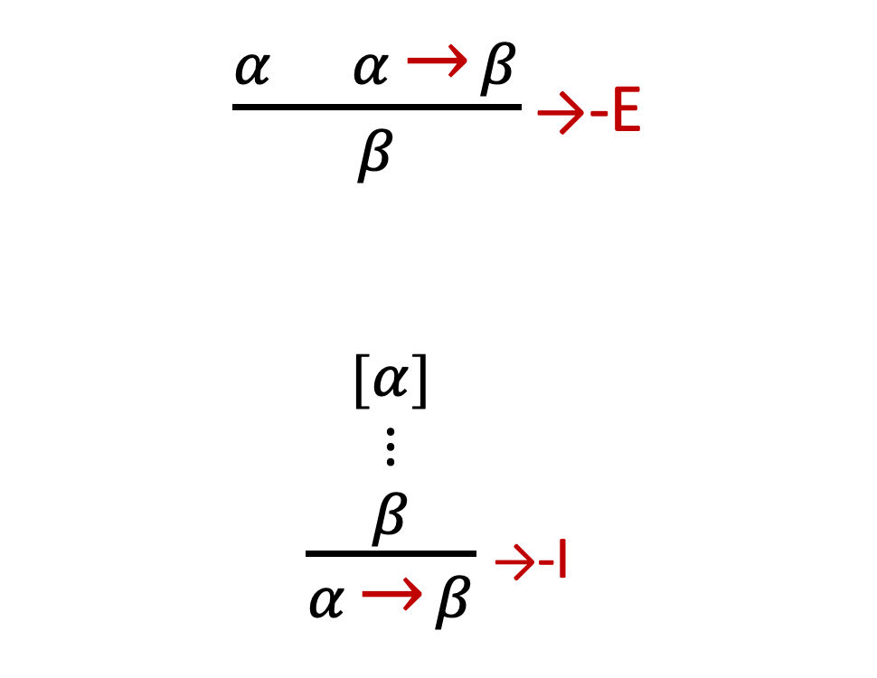
Implication rules
$\frac{α α \text{→} β}{β}\text{→}$-E
$\frac{\begin{matrix}[α] \\ ⋮ \\ β\end{matrix}}{α \text{→} β}$ $\text{→}$-I

Slide 19

Rules for "⊥"
$$\frac{\text{⊥}}{α} \text{⊥−}\text{E}\text{ (}\text{EFSQ}\text{)}$$
$\frac{\begin{matrix}[α] \\ ⋮ \\ \text{⊥}\end{matrix}}{¬α} ¬$-I (TND)

Slide 20
First Order Calculus (FOL)
FOL is an extension of CPC
Signature is extended by
Variables
Quantifiers ∀ and ∃
[, ]
Function symbols each associate to its arity, a natural number including 0. When the arity is 0 the functions are individual constants
Predicate symbols each associate to its arity, a natural number including 0. When the arity is 0 the predicates are propositional letters

Slide 21
Terms
Variables
For any function f, of arity n, the expression f(t₁ , t₂ … t_{n}) (with t_{i} terms)

Slide 22
WFF
Given a predicate p of arity n, and n terms t₁ , t₂ … t_{n} an unquantified wff is
p(t₁ , t₂ … t_{n})
Given a wff 𝝋 and a variable x,
∀x [𝝋] e ∃x [𝝋] are wff.

Slide 23
Closed vs open
Given a wff 𝝋, a variable x not in the scope of a quantifies ∀x or ∃x in 𝝋, is said to be free. On the opposite side, the variable is bound.
A wff 𝝋 is open when a variable in 𝝋 is free.
Closed wffs are propositions

Slide 24
Identity
FOL⁼ is equipped with a binary predicate, identity
The relation has the exact semantics of identiy in a domain

Slide 25
Interpretation of FOL: structures
Variables and constants are interpreted in a domain ∆
Functions of arity n are functions from ∆^{n} to ∆
Predicates of arity n are relations ∆^{n}

Slide 26
FOL semantics: formulae
An open formula behaves exactly as a predicate of arity equal to the number of free variables (arity of the formula)
An open formula is a boolean functions f, f: ∆^{n}→{T,F}
Unquantified closed formulae are interpreted as true or false

Slide 27
Interpretation and assignement
We name interpretation a function that associates to a FOLT a semantic value for predicates and functions in a domain ∆
We name assignement a function that associates a value to every variable appearing a in a FOLT to an element in ∆

Slide 28
Ground sat closed and ∆-sat formulae
Given a closed unquantified formula 𝝋, 𝝋 is SAT iff it exists at least an interpretation of predicates and functions such that there exists an assignement for 𝝋 that makes 𝝋 true.
Given a domain ∆, a closed unquantified formula 𝝋 is ∆-SAT if SAT in a fixed domain ∆.

Slide 29
Closed quantified formulae
Given an open formula 𝝋 only open in x, we say that
∀x[𝝋(x)] is SAT iff there is an interpretation of 𝝋 that makes 𝝋 true for any assignement of x
∃x[𝝋(x)] is SAT iff there is an interpretation of 𝝋 that makes 𝝋 true for at least for one assignement of x

Slide 30
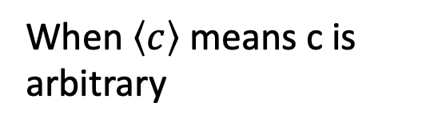
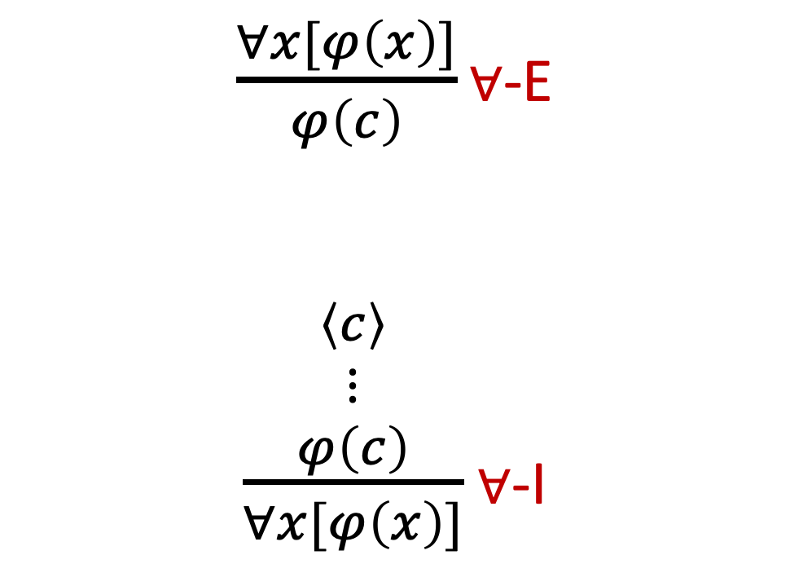
Rules for universal quantifier
$\frac{∀x[φ\left(x\right)]}{φ\left(c\right)}\text{∀}$-E
$\frac{\begin{matrix}\left\langle c\right\rangle \\ ⋮ \\ φ\left(c\right)\end{matrix}}{∀x[φ\left(x\right)]}$ $\text{∀}$-I
When $\left\langle c\right\rangle$ means c is arbitrary

Slide 31


Rules for existential quantifier
$\frac{φ\left(c\right)}{∃x[φ\left(x\right)]}\text{∃}$-I
$\frac{∃x[φ\left(x\right)]}{\frac{\begin{matrix}\left\{c\right\} φ\left(c\right) \\ ⋮ \\ Q\end{matrix}}{Q}}\text{∃}$-E
When $\left\{c\right\} means c is new$
Prawitz system is sound and complete for FOL

Slide 32
Computational problems
Syntactic tasks
Is a formula SAT?
Is a theory consistent?
Is a formula T-SAT?

Slide 33
Computational problems
Semantic tasks
Give a model for a formula
Give a model for a theory
Decide if a given model satisfies a theory

Slide 34

Resolution
$$\frac{\begin{matrix}L∨C & ¬L∨D\end{matrix}}{C∨D}$$

Slide 35
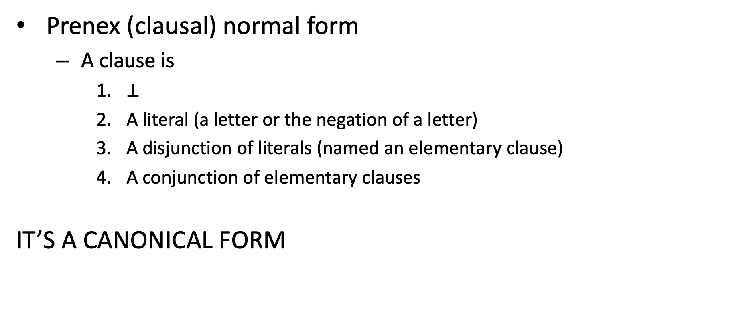
Prenex (clausal) normal form
Prenex (clausal) normal form
A clause is
$\text{⊥}$
A literal (a letter or the negation of a letter)
A disjunction of literals (named an elementary clause)
A conjunction of elementary clauses
IT’S A CANONICAL FORM

Slide 36
Davis-Putnam
To decide SAT
It is based on the resolution principle

Slide 37
Concept
We devise a set of rewriting rules to determine wether a given formula is actually
We represent a formula as a set of elementary clauses

Slide 38
Rewriting method (1)
PROPAGATION PHASE
For every element marked as new in the solution set, propagate it directly into the elementary clauses:
When it appears natural (namely in the same form of the solution set) remove the clause
When it appear negated, delete it from the clause
Once operated the steps above, remove the mark of new

Slide 39
Rewriting method (2)
DECISION STEP
During the propagation process, check when a clause becomes empty. When this happens, terminate the process with UNSAT
At the end of the propagation phase, control if the set of clauses is empty. If this is the case, terminate the process and return the solution set

Slide 40
Rewriting method (3)
OPERATION PHASE
As we shall see below, we have three rules involved
Unit propagation
Pure literal propagation
Resolution
The operation phase consists in
Checking the applicability of unit propagation or pure literal propagation
If they do not apply, apply resolution

Slide 41
RULES
Unit clause propagation: when a clause is unitary move the literal of the clause into the solution set, marked as new.

Slide 42
RULES
Pure literal propagation: when a literal appears in the clause set always in the same form, namely natural or negated, put that literal in the solution set.

